Slide 1

Department of Computer Science and Engineering
Music Genre Classification Using Deep Learning
PRESENTED BY
K Ravi Varma (20471A05F6)
M Kodanda Rami Reddy (20471A05G2)
Shaik Madire Ashaduddeen (20471A05I3)
Under the Guidance of,
Shaik Rafi _{M.tech,(Ph.D)}
Asst Professor
Department of Computer Science and Engineering,
Narasaraopeta Engineering College (Autonomous),
Narasaraopet- 522 601.

Slide 2
OUTLINE
Abstract
Introduction
Literature Survey
Research Gaps
Problem Statement
Objectives
Block Diagram / Flow Diagram
Methodology
Implementation
Results and Analysis
Conclusion & Future Scope
References
Question and Answers
Acknowledgements

Slide 3
ABSTRACT
Music genre classification is a pivotal area of research within audio technology, holding immense importance for content organization and recommendation. Audio feature extraction and Music genre classification constitute a complete recognition system.Audio feature analysis and Music genre classification together form an integrated recognition system for comprehensive music genre identification and organization.This technology is frequently utilized to accurately detect and classify various types of music genres or characteristics present in audio signals, contributing significantly to the effective organization and recommendation of music content.Our experiment was conducted with the dataset from GTZAN that is taken from Kaggle repository.Convolutional neural networks (CNN) are employed to train our model, which is subsequently utilized for the classification of music genres in audio signals.

Slide 4
INTRODUCTION
Imagine a world where your music collection understands you, curating playlists that perfectly suit your mood. Today, let's explore the realm of Music Genre Classification using Convolutional Neural Networks (CNNs) and the resilient Keras framework. It's not just about technology; it's about transforming soundwaves into musical revelations, ensuring your listening journey is a seamless and delightful experience for a harmonious musical future.
Imagine a musical journey where technology effortlessly understands and categorizes the diverse genres that resonate with you. In a world overflowing with musical choices, our aim is simple: let's empower technology to recognize and appreciate the unique vibes and tones in audio, making your music exploration more intuitive and creating a truly delightful listening experience.
Why does it matter? It's about infusing magic into our music experience. Music Genre Classification becomes the gateway to turning the symphony of sounds into a soundtrack that resonates with you. From curating playlists that fit your vibe to making every note more enchanting, it's a transformative tool for a more soulful musical experience.

Slide 5
LITERATURE SURVEY
No | Title | Author | Journal Name & Year | Methodology Adapted | Key Findings | Gaps
1 | Music Genre Classification: A Review of Deep-Learning and Traditional Machine-Learning Approaches | Ndiatenda Ndou, Ritesh Ajoodha , Ashwini Jadhav | https://ieeexplore.ieee.org/abstract/document/9422487 | Compare traditional and deep models and evaluate duration impact. | k-Nearest Neighbours is the best among all traditional models | Limited use of deep learning models
2 | Applications of Deep Learning to Audio Generation | Yuanjun Zhao, Xianjun Xia, Roberto Togneri | https://ieeexplore.ieee.org/abstract/document/8873418 | Multi-Layer Perceptron,SVM | Identified the effectiveness of CNNs. | Lack of an evaluation metric
3 | Some Reflections on the Potential and Limitations of Deep Learning for Automated Music Generation | Luca Casini, Gustavo Marfia, Marco Roccetti | https://ieeexplore.ieee.org/abstract/document/8581038 | RNN, Generative Adversarial Networks | Deploying VAEs,LSTM | Limited exploration of the scalability of the proposed model implementation challenges.
4 | Generating Music Algorithm with Deep Convolutional Generative Adversarial Networks | Hongyu Chen, Qinyin Xiao, Xueyuan Yin | ieeexplore.ieee.org/abstract/document/8839521 | Involves a GAN to Accurately detect | Identified High Accuracy, fullchannel lateral,piano-roll | The model is theoretically mature and has ideal properties

Slide 6
LITERATURE SURVEY
No | Title | Author | Journal Name & Year | Methodology Adapted | Key Findings | Gaps
5 | Deep neural network based instrument extraction from music | Stefan Uhlich, Franck Giron, Yuki Mitsufuji | https://ieeexplore.ieee.org/abstract/document/7178348 | DNN,BSS | SEPARATION, SDR | The material length and quality of the solo performances is impossible to Unseen instruments

Slide 7
RESEARCH GAPS
Limited Integration of Deep Learning Models:
While traditional methods have been explored, there is a noticeable absence of extensive integration and exploration of the potential benefits that deep learning architectures can offer in improving accuracy and robustness.
Robustness to Changes in Music Trends and Styles Over Time:
Research could focus on the robustness of classification algorithms in adapting to changes in music trends and styles over time, ensuring continued accuracy and relevance.
Real-time Processing for Dynamic Music Streaming:
Despite advancements in classification accuracy, there's a need for research focusing on real-time processing capabilities, especially in the context of dynamic music streaming applications.

Slide 8
PROBLEM STATEMENT
In our pursuit of advancing music genre classification for an enriched listening experience, the effectiveness of Music Genre Classification stands as a critical component.
Nevertheless, existing Music Genre Classification systems face obstacles that hinder their optimal performance and seamless integration.
Addressing these challenges is imperative to ushering in a revolutionary era in music recommendation systems and personalized audio content delivery.

Slide 9
OBJECTIVES
Implementing CNN for Music Genre Classification
Boosting Model Effectiveness
Enabling quick and accurate music genre classification for music enthusiasts
Model validation on GTZAN dataset

Slide 10
BLOCK DIAGRAM OR FLOW DIAGRAM
Data Collection
Performing EDA
Splitting The Data
Training CNN Model
Applying Column Transformer
Validating Results

Slide 11
METHODOLOGY
The model is fed using Kaggle “GTZAN” dataset.
The dataset consists of 60 attributes, namely chroma_stft_mean, rms_var, mfcc1_var and many more which are used for the classification of music data.
There are 6 modules in this project. Where every single module performs certain task.
Module-1: The model uses the data, which is obtained from Kaggle GTZAN dataset.
Module-2 : Finding If there are any null values and duplicated rows are are present
Module-3 : Performing Exploratory data analysis and identifying key findings
Module-4 : To address temporal and frequency distortions in music spectrogram recognition and enhance feature extraction, the CNN method is employed. The spectrogram's magnitude spectrum is computed, and this information is used to generate CNN features.

Slide 12
METHODOLOGY
Module-5 : Applying a ColumnTransformer to a dataframe involves utilizing Yeo-Johnson
Transformation, standardization, and normalization within the ColumnTransformer.
Module 6 : The CNN is designed to capture hierarchical features, complemented by multi-level residual branches to prevent overfitting and augment feature extraction in the context of music genre classification.

Slide 13
IMPLEMENTATION
Software Specifications:
Browser: Any latest browser like Chrome
Operating System: Windows 7 Server or later
Python (COLAB)
Hardware Specifications:
Processor: Intel® Dual Core 2.0GHz minimum
Hard Disk: 1TB minimum
RAM: 8GB or more

Slide 14
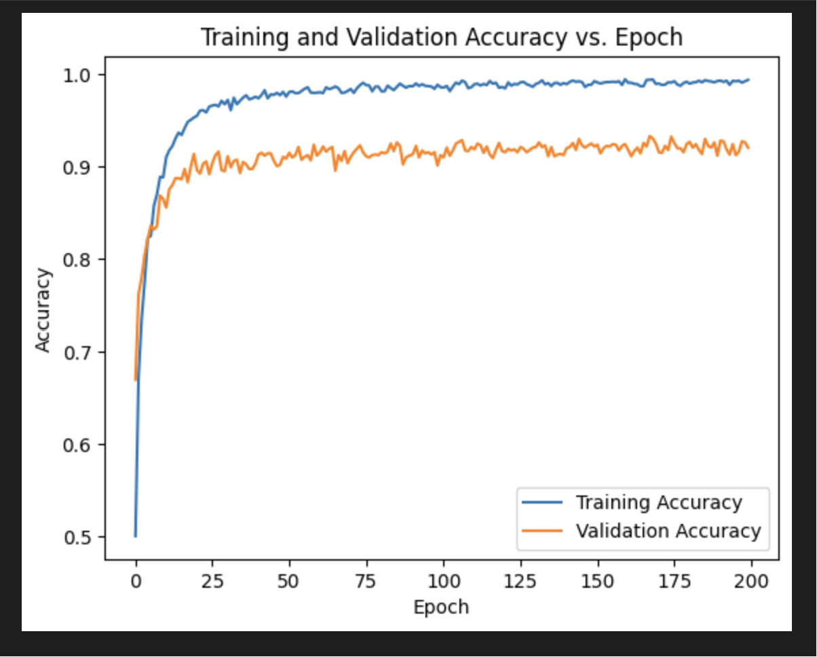
RESULTS & ANALYSIS
Accuracy Score is 91.58

Slide 15
CONCLUSION and FUTURE SCOPE
CONCLUSION :
The refined Music Genre Classification model excels under varying acoustic conditions, showcasing precision and adaptability. Leveraging Convolutional Neural Networks (CNN) and the versatile Keras framework
By using this approach, more unique and import classes of data can be closely visualized.
Greater effectiveness becomes evident, particularly in challenging acoustic environments, when it comes to music genre classification.
Future Scope:
Future research in music genre classification should prioritize real-time monitoring, ongoing model refinement, interpretability, and validation across diverse user populations. The integration of multi-modal data and listener-centric approaches will contribute to the evolution of personalized and effective music genre classification.

Slide 16
REFERENCES
[1] R. Ajoodha, R. Klein, and B. Rosman, “Single-labelled music genre classification using content-based features,” in 2015 Pattern Recognition Association of South Africa and Robotics and Mechatronics International Conference (PRASA-RobMech), 2015, pp. 66–71.
[2] R. Ajoodha, R. Klein, and M. Jakovljevic, “Using statistical models and evolutionary algorithms in algorithmic music composition,” in Encyclopedia of Information Science and Technology, Third Edition. IGI Global, 2015, pp. 6050–6062.
[3] H. Bahuleyan, “Music genre classification using machine learning techniques,” 2018. https://doi.org/10.3390/sym11030343
[4] E. Benetos and C. Kotropoulos, “A tensor-based approach for automatic music genre classification,” in 2008 16th European Signal Processing Conference, 2008, pp. 1–4.
[5] J. Bergstra, N. Casagrande, D. Erhan, D. Eck, and B. Kégl, “Aggregate features and adaboost for music classification,” Machine Learning, vol. 65, pp. 473–484, 12 2006.
[6] K. Choi, G. Fazekas, and M. Sandler, “Explaining deep convolutional neural networks on music classification,” 2016.

Slide 17
[7] F. Chollet et al., “Keras,” https://github.com/fchollet/keras, 2015.
[8] I. Fujinaga, “Adaptive optical music recognition,” Ph.D. dissertation, McGill University, CAN, 1997, aAINQ29937.Sci. 2020, 10, 1245. https://doi.org/10.3390/app10041245
[8] Liu B, Ding Z, Tian L, He D, Li S and Wang H (2020)Grape Leaf Disease Identification Using Improved Deep Convolutional Neural Networks. Front. Plant Sci. 11:1082.
[9] D. S. Lau and R. Ajoodha, “Music genre classification: A comparative study between deep-learning and traditional machine learning approaches,” in Sixth International Congress on Information and Communication Technology (6th ICICT). Springer, 2021, pp. 1–8.
[10] J. H. Lee and J. S. Downie, “Survey of music information needs, uses, and seeking behaviours: preliminary findings.” in ISMIR, vol. 2004. Citeseer, 2004, p. 5th.
[11] A. Lerch, An Introduction to Audio Content Analysis: Applications in Signal Processing and Music Informatics. Wiley Online Library, 10 2012.
[12] T. Li, M. Ogihara, and Q. Li, “A comparative study on content-based music genre classification,” in Proceedings of the 26th Annual International ACM SIGIR Conference on Research and Development in Informaion Retrieval, ser. SIGIR ’03. New York, NY, USA: Association for Computing Machinery, 2003, p. 282–289. [Online]. Available: https://doi.org/10.1145/860435.860487

Slide 18
[13] T. Lidy, A. Rauber, A. Pertusa, and J. Iñesta, “Combining audio and symbolic descriptors for music classification from audio,” 2007.
[14] C. McKay, R. Fiebrink, D. McEnnis, B. Li, and I. Fujinaga, “Ace: A framework for optimizing music classification,” in ISMIR, 2005.
[15] C. McKay and I. Fujinaga, “Musical genre classification: Is it worth pursuing and how can it be improved?” in ISMIR, 2006.
[16] T. Nkambule and R. Ajoodha, “Classification of music by genre using probabilistic graphical models and deep learning models,” in Sixth International Congress on Information and Communication Technology (6th ICICT). Springer, 2021, pp. 1–6.
[17] A. Olteanu. Gtzan dataset - music genre classification. [Online]. Available: https://www.kaggle.com/andradaolteanu/gtzan-dataset-musicgenre-classification
[18] F. Pedregosa, G. Varoquaux, A. Gramfort, V. Michel, B. Thirion, O. Grisel, M. Blondel, A. Müller, J. Nothman, G. Louppe, P. Prettenhofer, R. Weiss, V. Dubourg, J. Vanderplas, A. Passos, D. Cournapeau, M. Brucher, M. Perrot, and Édouard Duchesnay, “Scikit-learn: Machine learning in python,” 2018.

Slide 19

ANY QUESTIONS ?

Slide 20

Thank You

